Slide 1
Meeting Week 21
Last week summary
Augmentation
  Encoder
Parameter recovery smaller max angle difference X1 and X2 (Theta)
Outline ToDo next week

Slide 2
Last week summary
Discussed different encoder methods
  Hybrid encoder didn’t allow to flow gradients through it
  Jan’s linear encoder initialization
    Start with a good estimate
    But training worsened / was worse than init
  Culprit most likely was a parameter problem

Slide 3
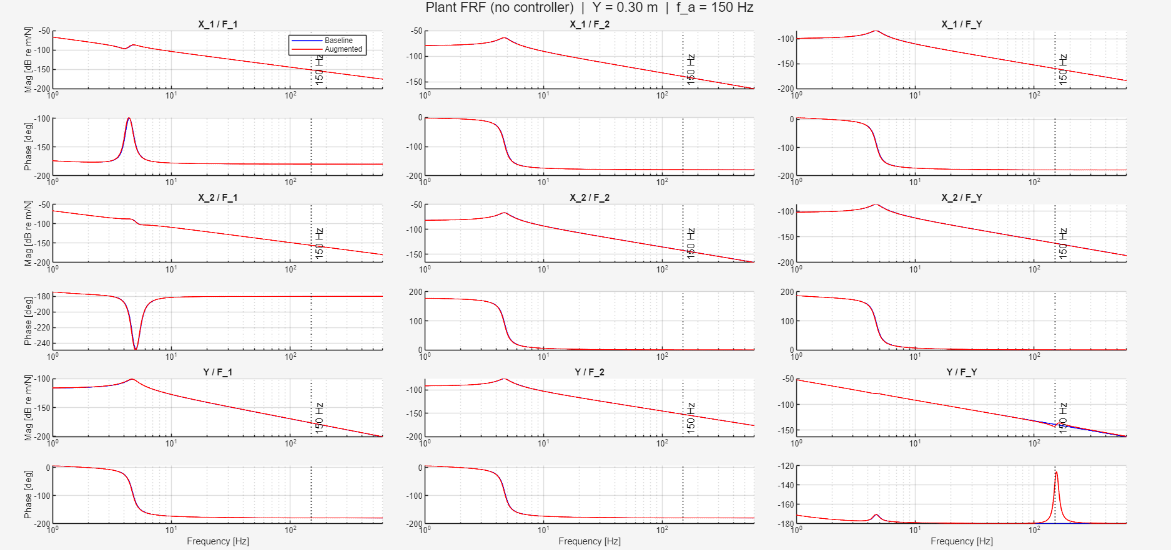

Slide 4
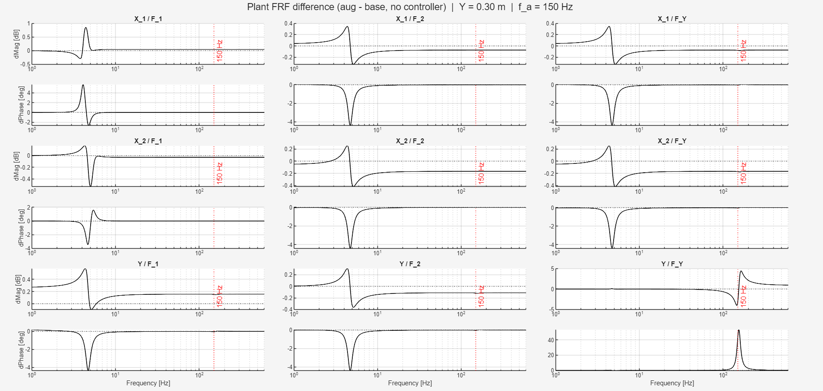

Slide 5
Error between baseline and augmented
Given the same input from closed-loop augmented system to the baseline system.
  What is the difference
Why:
  Want to know whether the baseline model given the input from the augmented system

Slide 6
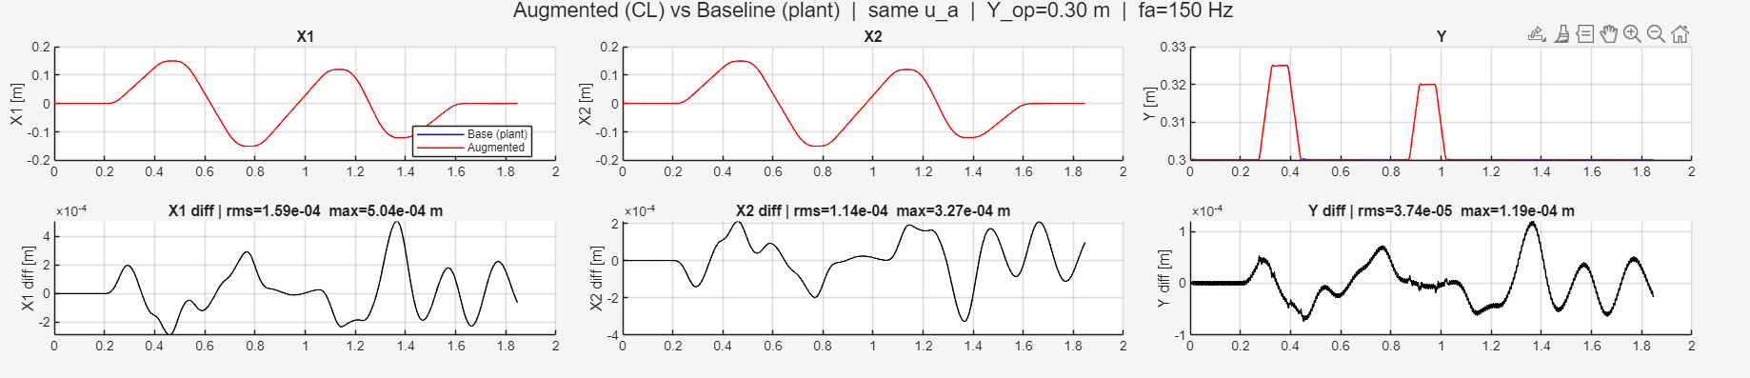
System with added MSD vs system without MSD
  Used the same input, compared the difference
Parameter recovery was able to get in the range e^-7
  With perfect parameters / perfect model is able to get in that range
  We have no noise currently

Slide 7
What is the encoder?
neural network that maps past I/O history (u_past, y_past) to an initial state x0
x0 contains both physical states (positions, velocities) and
ANN augmentation states

Slide 8
Why do we need it?
BPTT training rolls out the model for i-amount of steps from an initial state x0, but we only measure outputs (positions), not the full state
Analytical alternative positions from measurements, velocities from finite differences, ANN states = 0
ANN augmentation states have no physical meaning
Notes:
is not differentiable, so gradients cannot improve x0 during training

Slide 9
Augmentation structure
x(k+1) = f_phys(x_phys, u) + f_NN(x, u)
  x is the full 8-dimensional state vector (6 physical + 2 augmented)
  x_phys is the first 6 entries of x (just the physical states, selected via S)
Physics block: known LPV gantry model (fixed, not trained)
NN correction: feedforward network, zero-initialised (starts as pure physics)
State = 6 physical + 2 augmented
Output: y = C x_phys + D u (known, not trained)

Slide 10
Parameter justification
FRF
Chosen parameters

Slide 11
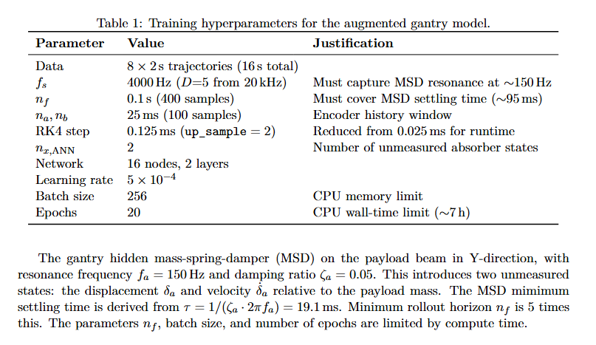
Parameter justification

Slide 12
Hybrid encoder
Baseline encoder couldn’t outperform analytical baseline for data with MSD
  Analytical baseline compute positions and velocities directly from output data
What the hybrid encoder does:
  Splits the job in two:
    Physical states (x_{1:6}): computed analytically. Detached from the computation graph so no gradients flow through them
    Augmented states (x_{7:8}): a small zero-init ANN learns these from the same past window
Trajectories not informative enough? → added multisine

Slide 13
Hybrid encoder + Multisine
Baseline encoder couldn’t outperform analytical baseline for data with MSD
  Analytical baseline compute positions and velocities directly from output data
What the hybrid encoder does:
  Splits the job in two:
    Physical states (x_{1:6}): computed analytically. Detached from the computation graph so no gradients flow through them
    Augmented states (x_{7:8}): a small zero-init ANN learns these from the same past window
Even with hybrid encoder good initialization but did not learn → data not informative enough? → added multisine to trajectories

Slide 14
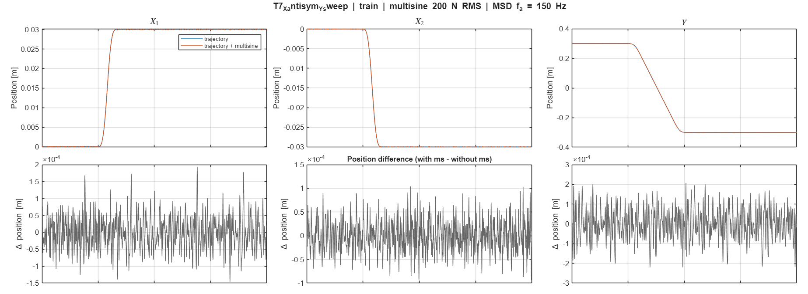

Slide 15
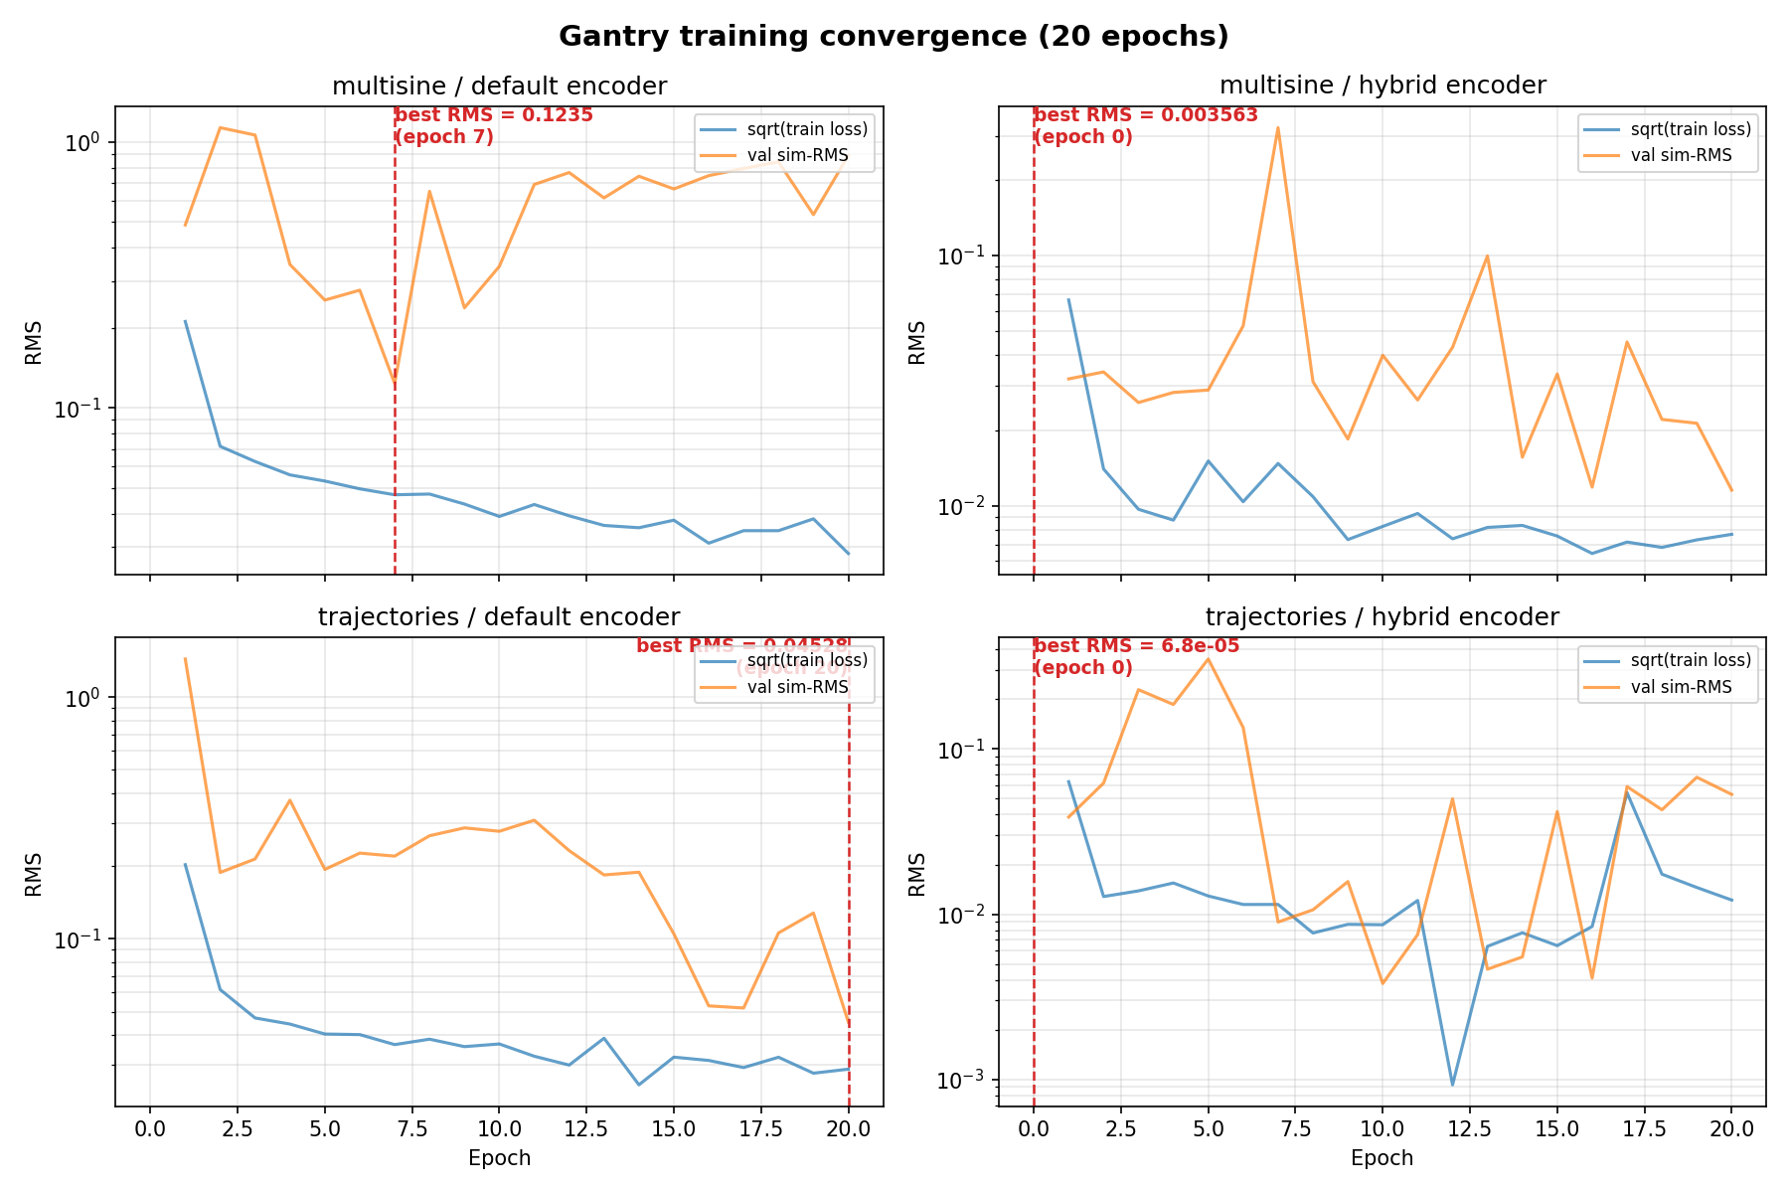
Analytical baseline order of magnitude e^-5 RMS
0.123539 RMS
0.003563 RMS
0.045276 RMS
0.000068 RMS

Slide 16
Problem with hybrid encoder
No gradients update through position and velocity states
The encoder needs to learn a mapping for I/O

Slide 17
Linear encoder initialization
Encoder weights initialized from the known baseline model
  ANN states are set to 0
  Method is for LTI so needed to choose an operating point for Y (Y=0)

Slide 18
System without MSD (Baseline)
--- BEFORE training: 20-step output prediction ---
Output 1-step NRMS 20-step NRMS
------ -------------- --------------
x1 6.4809e-05 2.6333e-04
x2 7.5406e-05 3.4315e-04
Y 2.7618e-05 8.5782e-05
Analytical 20-step output prediction:
Output 1-step NRMS 20-step NRMS
------ -------------- --------------
x1 7.5820e-06 6.3784e-05
x2 6.9332e-06 5.1355e-05
Y 5.5282e-06 4.5105e-05
--- AFTER training: 20-step output prediction ---
Output Init 1-step Trained 1-step Analytical 1-step
------ -------------- -------------- ------------------
x1 6.4809e-05 9.1409e-05 7.5820e-06
x2 7.5406e-05 1.0084e-04 6.9332e-06
Y 2.7618e-05 2.0631e-05 5.5282e-06
Output Init 20-step Trained 20-step Analytical 20-step
------ -------------- -------------- ------------------
x1 2.6333e-04 8.7203e-05 6.3784e-05
x2 3.4315e-04 9.5679e-05 5.1355e-05
Y 8.5782e-05 3.1232e-05 4.5105e-05

Slide 19
System with MSD
======================================================================
COMPARISON: Physical state NRMS
======================================================================
State NX_ANN=0 NX_ANN=2 Analytical
-------- -------------- -------------- -------------- ----------
X 2.9443e-04 2.8072e-04 0.0000e+00
theta 7.9312e-04 6.9085e-04 0.0000e+00
Y 2.2891e-04 1.0591e-04 0.0000e+00
dX 5.2102e-02 9.3972e-03 6.6885e-03
dtheta 1.4753e-01 3.2553e-01 9.5385e-02
dY 3.7484e-02 4.1815e-02 1.0123e-02

Slide 20
Parameter recovery
Max angle 0.006 meters previously 0.072 meters
Motion profiles no multisine
Slides compare results
  Left “original” 0.072 meters (best epoch 660)
  Right 0.006 meters (best epoch 660)

Slide 21
[Training]
Traj RMSE [m] X1 [m] X2 [m] Y [m]
------ ------------ ---------- ---------- ----------
T1 2.3363e-07 4.7875e-10 4.4967e-10 4.0467e-07
T2 1.8340e-07 2.2466e-07 2.2457e-07 4.8999e-10
T3 1.8342e-07 2.2476e-07 2.2451e-07 1.1326e-09
T4 1.0077e-08 1.0706e-08 1.3624e-08 2.0930e-09
T5 2.1265e-07 1.5083e-07 1.5055e-07 3.0041e-07
T6 2.6837e-07 1.4659e-09 1.5980e-09 4.6482e-07
T7 2.5686e-07 1.0754e-08 1.3987e-08 4.4454e-07
T8 2.0804e-07 1.4032e-07 1.3801e-07 3.0184e-07
Train RMSE: 2.087048e-07 m
[Training]
Traj RMSE [m] X1 [m] X2 [m] Y [m]
------ ------------ ---------- ---------- ----------
T1 9.8580e-08 4.9997e-08 4.8472e-08 1.5590e-07
T2 7.7395e-07 9.4786e-07 9.4792e-07 2.6151e-09
T3 7.7403e-07 9.4815e-07 9.4783e-07 3.9236e-09
T4 3.4861e-07 4.6253e-07 3.6898e-07 1.2043e-07
T5 5.0220e-07 6.0797e-07 6.1185e-07 1.1240e-07
T6 1.6992e-07 1.5966e-07 1.7504e-07 1.7462e-07
T7 3.1902e-07 3.6804e-07 3.5306e-07 2.1266e-07
T8 6.5265e-07 7.8215e-07 8.0278e-07 1.4712e-07
Train RMSE: 5.169837e-07 m

Slide 22
[Validation]
Traj RMSE [m] X1 [m] X2 [m] Y [m]
------ ------------ ---------- ---------- ----------
V1 1.6160e-07 1.1340e-07 1.1322e-07 2.2948e-07
Val RMSE: 1.615967e-07 m
[Test]
Traj RMSE [m] X1 [m] X2 [m] Y [m]
------ ------------ ---------- ---------- ----------
E1 1.2995e-07 8.5397e-08 8.3640e-08 1.9072e-07
Test RMSE: 1.299505e-07 m
[Validation]
Traj RMSE [m] X1 [m] X2 [m] Y [m]
------ ------------ ---------- ---------- ----------
V1 3.6852e-07 4.4564e-07 4.4871e-07 8.6497e-08
Val RMSE: 3.685197e-07 m
[Test]
Traj RMSE [m] X1 [m] X2 [m] Y [m]
------ ------------ ---------- ---------- ----------
E1 3.7594e-07 4.4753e-07 4.6311e-07 9.6125e-08
Test RMSE: 3.759383e-07 m

Slide 23
================================================
Step 5: Parameter recovery
============================================================
Table 1 — identifiable quantities
Parameter True Detuned Learned delta
-------------------------------------------------------
kb_sum 3975.0000 4372.5000 3974.9998 -0.00%
cg1 14.5000 15.9500 14.5000 -0.00%
cg2 20.3000 18.2700 20.2999 -0.00%
cy 10.0000 11.0000 10.0000 -0.00%
cb_sum 18.0000 16.2000 17.9999 -0.00%
mh 10.1000 9.0900 10.1000 -0.00%
m_total 43.7000 45.9300 43.6999 -0.00%
m_diff -0.5000 1.5900 -0.5000 -0.00%
J_eff 3.7964 3.6848 3.7964 -0.00%
d 0.1000 0.1100 0.1000 +0.00%
================================================Step 5: Parameter recovery
============================================================
Table 1 — identifiable quantities
Parameter True Detuned Learned delta
-------------------------------------------------------
kb_sum 3975.0000 4372.5000 3975.0388 +0.00%
cg1 14.5000 15.9500 14.4996 -0.00%
cg2 20.3000 18.2700 20.2997 -0.00%
cy 10.0000 11.0000 10.0000 -0.00%
cb_sum 18.0000 16.2000 18.0769 +0.43%
mh 10.1000 9.0900 10.1000 -0.00%
m_total 43.7000 45.9300 43.7001 +0.00%
m_diff -0.5000 1.5900 -0.5000 +0.01%
J_eff 3.7964 3.6848 3.7939 -0.07%
d 0.1000 0.1100 0.1000 -0.01%

Slide 24
Table 2 — split diagnostics (not data-identifiable)
Parameter True Detuned Learned delta
-------------------------------------------------------
kb1 1987.5000 2186.2500 1987.4999 -0.00%
kb2 1987.5000 2186.2500 1987.4999 -0.00%
cb1 9.0000 8.1000 9.0000 -0.00%
cb2 9.0000 8.1000 9.0000 -0.00%
Jb 1.0000 0.9000 0.9369 -6.31%
Jh 0.0500 0.0450 0.0468 -6.31%
m1 10.2000 11.2200 10.4520 +2.47%
m2 10.7000 9.6300 10.9520 +2.36%
mb 22.8000 25.0800 22.2959 -2.21%
J_sum 1.0500 0.9450 0.9838 -6.31%
Table 2 — split diagnostics (not data-identifiable)
Parameter True Detuned Learned delta
-------------------------------------------------------
kb1 1987.5000 2186.2500 1987.5194 +0.00%
kb2 1987.5000 2186.2500 1987.5194 +0.00%
cb1 9.0000 8.1000 9.0385 +0.43%
cb2 9.0000 8.1000 9.0385 +0.43%
Jb 1.0000 0.9000 0.9312 -6.88%
Jh 0.0500 0.0450 0.0466 -6.88%
m1 10.2000 11.2200 10.4651 +2.60%
m2 10.7000 9.6300 10.9651 +2.48%
mb 22.8000 25.0800 22.2698 -2.33%
J_sum 1.0500 0.9450 0.9778 -6.88%

Slide 25
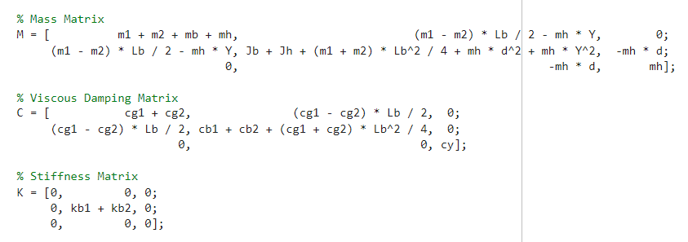

Slide 26
X, Theta, Y
Most affected cb_sum and J_eff → makes sense that these are the most affected in the theta row

Slide 27
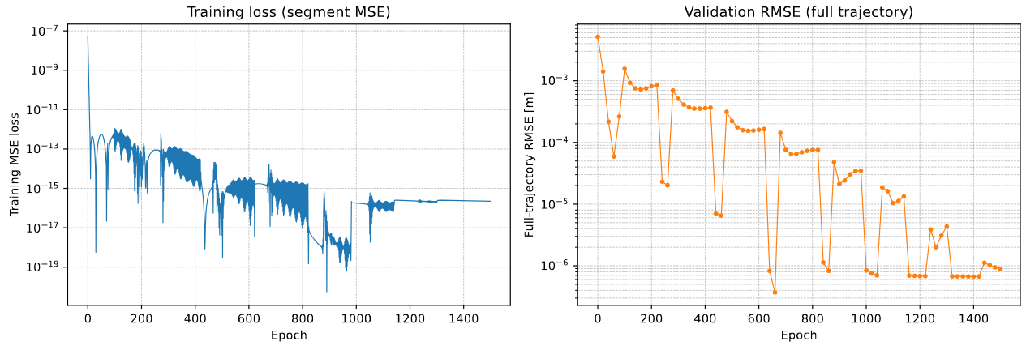

Slide 28
Outline next week
Wednesday joint meeting ASMPT-TU/e
  Overview of where we are now in the overall process
Further work on encoder and augmentation

Slide 30
--- BEFORE training: 20-step output prediction ---
Output 1-step NRMS 20-step NRMS
------ -------------- --------------
x1 6.4809e-05 2.6333e-04
x2 7.5406e-05 3.4315e-04
Y 2.7618e-05 8.5782e-05
--- AFTER training: 20-step output prediction ---
Output Init 1-step Trained 1-step Analytical 1-step
------ -------------- -------------- ------------------
x1 6.4809e-05 9.1409e-05 7.5820e-06
x2 7.5406e-05 1.0084e-04 6.9332e-06
Y 2.7618e-05 2.0631e-05 5.5282e-06
Output Init 20-step Trained 20-step Analytical 20-step
------ -------------- -------------- ------------------
x1 2.6333e-04 8.7203e-05 6.3784e-05
x2 3.4315e-04 9.5679e-05 5.1355e-05
Y 8.5782e-05 3.1232e-05 4.5105e-05

Slide 31
Velocity error dominates in the current position loss, because..
Because of that try state loss instead of only position based loss

Slide 32
Determine slowest dynamics
In python: gantry_linearization.py
probably better off doing this in matlab…

Slide 33
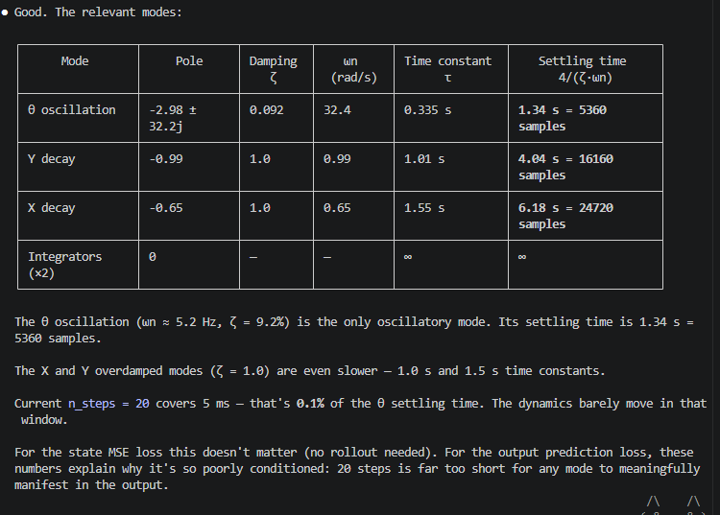
Sample lengths n_steps / nf

Slide 34
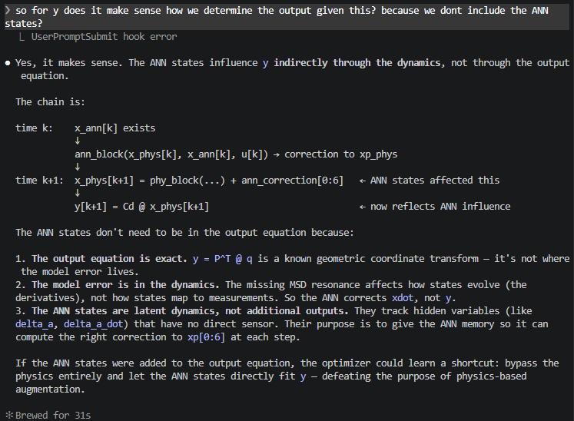

Slide 35
Previous data
Only 8000 x 8 samples
  (Total 20khz at 2 seconds each)
Feedback that they were too stale
  Added oscillations
Why make new data
  Needed more data
  Too much of the motion profiles / data were hold positions at zero
    Besides when we add multisines on top off the trajectories
  More informative data / variation

Slide 36
More informative data
Oscillations and ramp up

Slide 37
More informative data
Oscillations and ramp up
For the baseline system (without MSD)
Also created trajectories + multisine
Frequency range 1-7hz gets surpressed by controller, but for baseline encoder this data should be informative enough without multisine

Slide 38
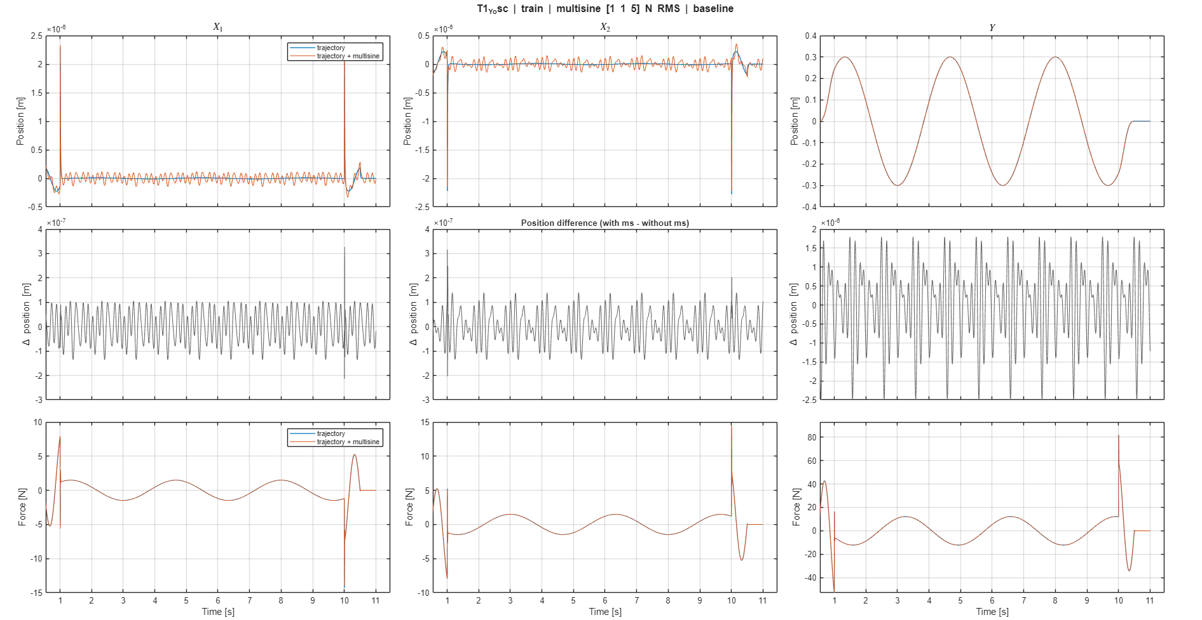

Slide 40
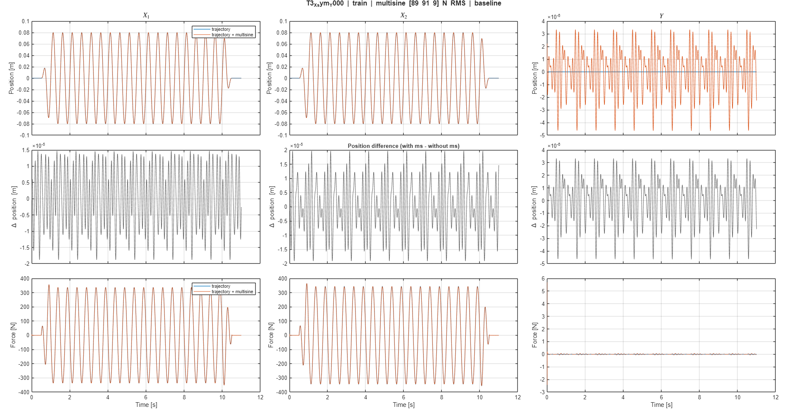

Slide 41
Downsampling
Look at whether rk4 degrades
Allows to run longer ??windows?? while still seeing entire trajectory.

Slide 42
Issue downsampling and encoder initialization

Slide 43
nf: number of samples
Main issue with increasing the sample length
  Scales with …
Currently grid search for nf and lr

Slide 44
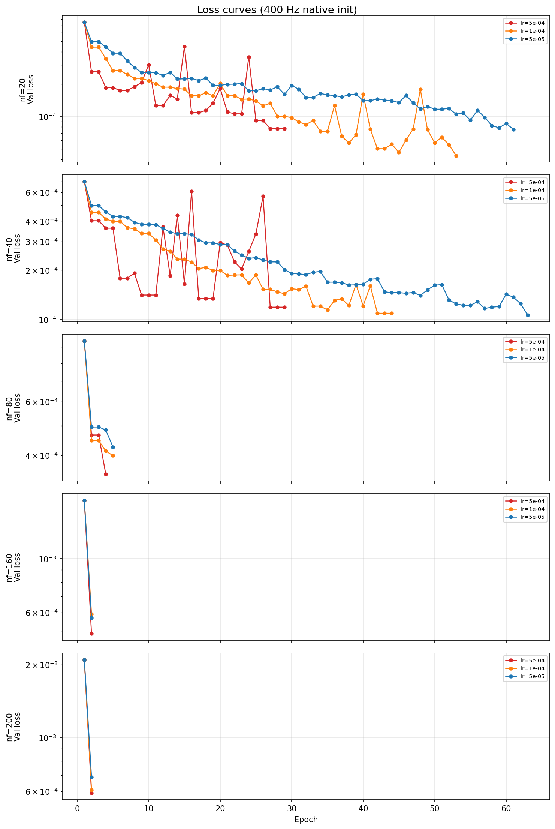
Encoder baseline
Only physical states
Early stopping when we drift off too much from initialization
Validation loss =
{nf}-step-RMS nf-step-ahead RMS of the output prediction (y) on the validation set.

Slide 45
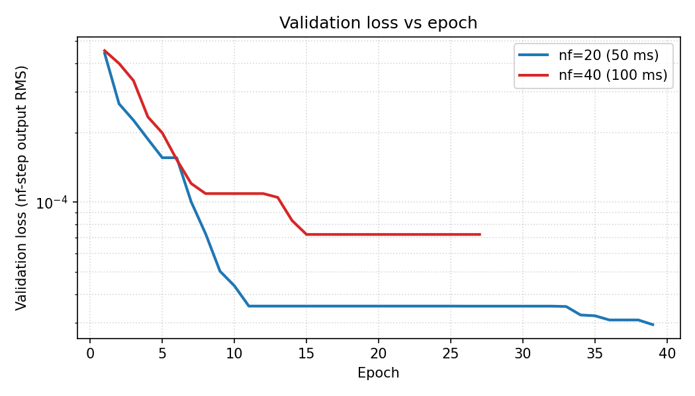

Slide 46
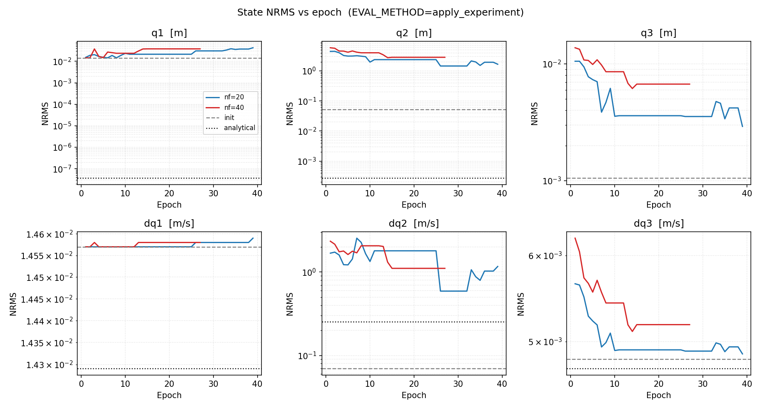

Slide 47
States worsen
Train for output prediction
  Cost does not target the states
For the augmentation phase could use a regularization for the physical states to keep close to the init
  If keeping physical states for the encoder adds value

Slide 48
3. Why does accuracy decrease as nf increases?
Your "more initializations" intuition is partially correct — shorter nf means more training windows per sequence
(the window count is ≈ N − na − nb − nf, so lower nf = more samples). But the dominant reason is gradient quality:
- With nf=20, the loss gradient flows back through 20 RK4 steps — the encoder gets a clean, direct signal about
how to improve the initial state estimate.

Slide 49
Yes, both apply_experiment jobs (nf=20 and nf=40) are worse than their own init at every epoch logged so far. The
encoder is being pushed in a direction that hurts the full-pipeline rollout, even as the nf-step output loss
(val_loss) improves. This is the key tension: the training objective (nf-step output RMS) and the evaluation
metric (apply_experiment state NRMS) are not aligned.

Slide 50
Outline next week
Encoder for augmentation
Evaluate Quinten’s data for parameter recovery method
  See whether our baseline fits the data

Slide 51
Planning
Project overview
If possible can you share your vacation days with me

Slide 52
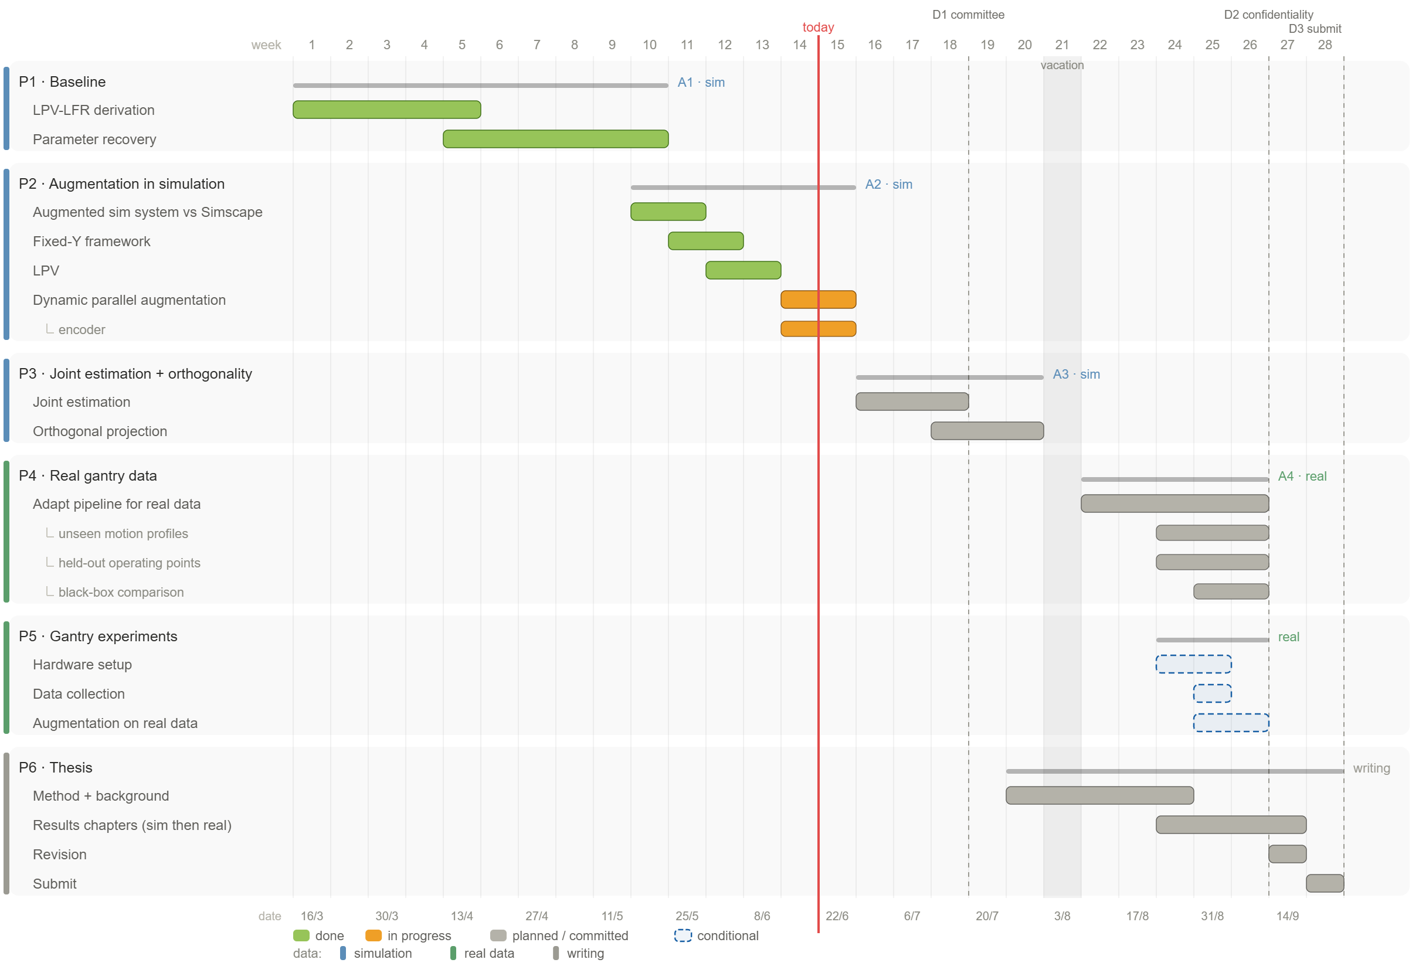

Slide 53


Slide 54


Slide 56
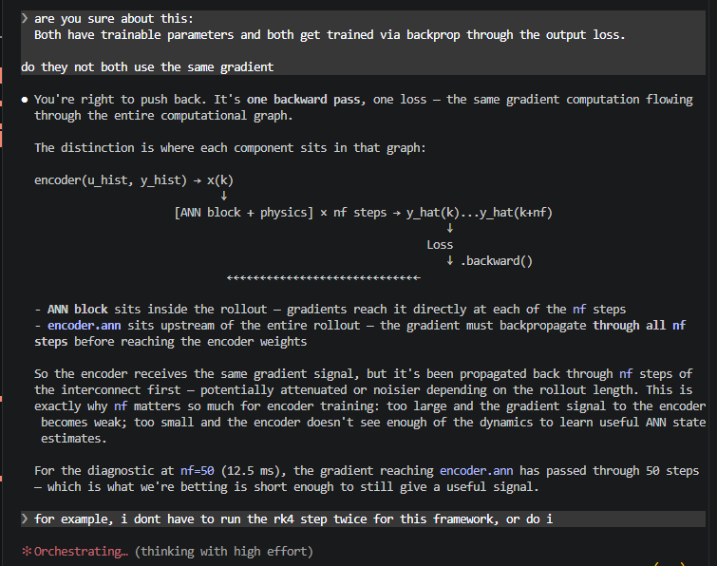
Additional

Slide 57
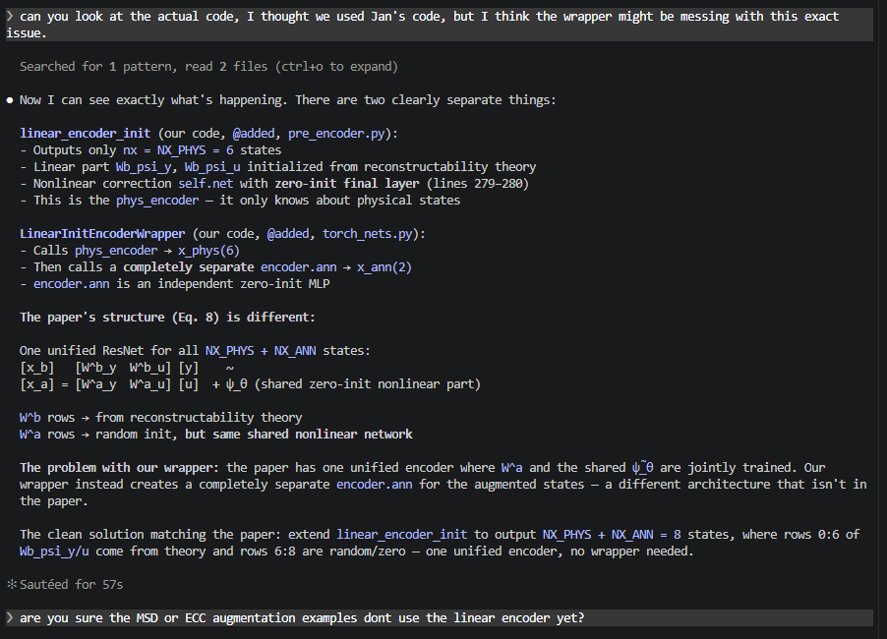
The problem with our wrapper: the paper has one unified encoder where W^a and the shared ψ̃_θ are jointly trained. Our
wrapper instead creates a completely separate encoder.ann for the augmented states — a different architecture that isn't in
the paper.

Slide 58
Complete model picture with formulas where does the encoder fit in (we change / add the formulas)

Slide 59
Vragen aan jan
Good call -- LinearInitEncoderWrapper is architecturally wrong (two separate nets) and the Eq. 8
extension is the right thing to do.
The plan would be:
New class @added linear_encoder_init_aug in pre_encoder.py:
- Copy Jan's linear_encoder_init verbatim
- Add nx_aug=0 parameter
- Add Wa_psi_y and Wa_psi_u as nn.Parameter with small random init for the nx_aug extra rows
- Expand self.net output from nx to nx + nx_aug (same zero-init final layer)
- Forward: x_lin = cat([Wb @ [y,u], Wa @ [y,u]]) + one shared self.net(...)
- When nx_aug=0 it behaves identically to Jan's original (backward compatible)
Then in torch_nets.py:
- Delete LinearInitEncoderWrapper (marked @added, so it's ours to remove)
Then in gantry_interconnect_dynamic.py:
- Replace LinearInitEncoderWrapper(...) with linear_encoder_init_aug(nx_aug=NX_ANN, ...)
One open question before implementing: what scale for the W^a random init? The paper says "randomly
initialized" but doesn't specify. Options:
1. PyTorch default (kaiming_uniform_, what nn.Linear uses)
2. Small scale like 0.01 so augmented states start near zero at initialization
3. Same scale as W^b (match physical state magnitude)
Option 2 is the safest -- augmented states starting near zero at init is fine and avoids large initial
state estimates that could destabilize early training.
Shall I proceed with this implementation?
One open question before implementing: what scale for the W^a random init? The paper says "randomly
initialized" but doesn't specify. Options:
1. PyTorch default (kaiming_uniform_, what nn.Linear uses)
2. Small scale like 0.01 so augmented states start near zero at initialization
3. Same scale as W^b (match physical state magnitude)

Slide 60
Encoder augmented states initialization
Random in physical states range?
Just kaiming_uniform_ pytorch method?
  Ask Jan
What actually matters:
  At initialization, x_a should not dominate or destabilize the early training signal where x_b is already well-placed. The augmented states
  should start small and grow as the training loss drives them. This argues for small or zero init for W^a specifically.
Kaiming initialization was specifically mathematically derived to account for the zero-cutoff in ReLU activations.

Slide 61
Normalization
Why the pipeline currently uses mean subtraction
The fit_sys.norm mean subtraction (y0, u_mean) was introduced for the Gantry_State_Block, not for the encoder. The physics block needs (y - y0)/std_y because y0 = Cd @ x_mean
is the operating point of the linearization. Removing the mean from the norm would require verifying how the output block and loss reconstruction handle the operating point.
The Gantry_State_Block was derived as a linearized model for deviations from an operating point. The state-space equations x(k+1) = A(theta) x(k) + B u(k) describe how the
system moves away from the operating point. If you feed it absolute stage positions instead of deviations, it is being asked to model the wrong quantity.
x_mean is used for LPV scheduling via the Y channel.

Slide 62
Encoder difference minimal
Channel NRMS A NRMS B_wrap NRMS B_native
q1 0.000150 0.000002 0.000002
q2 0.000095 0.000002 0.000002
q3 0.000044 0.000002 0.000002
dq1 0.000051 0.000001 0.000001
dq2 0.000341 0.000004 0.000004
dq3 0.000239 0.000001 0.000001

Slide 63
New data
Had to much force thought it was a bug compared to the positions but..
da_rms_with / da_rms_without:

Slide 64
Parameter recovery better?
The gap: our script uses Adam (local gradient-based). For structural validation, a global search gives stronger evidence. The recommended hierarchy:
1. Differential Evolution (DE) — derivative-free, population-based, well-tested for 10-30 mechanical parameters. ~1k-5k ODE simulations, feasible in minutes for a 6-state
system.
2. Multi-start Adam as refinement after DE.

Slide 65
The real solution: decouple the two purposes
The experiments have two distinct jobs:
┌───────────────────────┬─────────────────┬────────────────────────────┐
│ Purpose │ Trajectories │ What excites it │
├───────────────────────┼─────────────────┼────────────────────────────┤
│ Y-scheduling coverage │ T1, T5 │ Y motion, broadband forces │
├───────────────────────┼─────────────────┼────────────────────────────┤
│ MSD identification │ T3, T4, T7, T10 │ X motion → 150 Hz coupling │
└───────────────────────┴─────────────────┴────────────────────────────┘
Narrowband multisine only belongs in trajectories with significant X motion. Y-only experiments (T1, T5) simply cannot excite the MSD without violating the small-signal
assumption — and they don't need to. The MSD parameters (fa, ζ, ma) don't vary with Y-scheduling position; they're fixed physical properties.

Slide 67
New data
Multisine now from 130-180hz for MSD data
  No joint estimation

Slide 68
FRF zetten van het systeem
Kijken wat te doen met verschillende nfs voor baseline en parameters
  Moet iets fatsoenlijks kunnen laten zien..

Slide 69
Settle time
---
Envelope time constant:
$$\tau = \frac{1}{\zeta \omega_n} = \frac{1}{\zeta \cdot 2\pi f_n}$$
\tau = \frac{1}{\zeta \omega_n} = \frac{1}{\zeta \cdot 2\pi f_n}
Settling time to tolerance $\varepsilon$:
$$t_s = \frac{-\ln \varepsilon}{\zeta \omega_n} \approx \frac{4}{\zeta \omega_n} \quad (2%),\quad \frac{3}{\zeta \omega_n} \quad (5%)$$
t_s = \frac{-\ln \varepsilon}{\zeta \omega_n}
Q factor (from FRF):
$$Q = \frac{f_r}{\Delta f_{3\text{dB}}} = \frac{1}{2\zeta}$$
Q = \frac{f_r}{\Delta f_{3\,\text{dB}}} = \frac{1}{2\zeta}
Time constant from Q (nonparametric):
$$\tau = \frac{Q}{\pi f_r}$$
\tau = \frac{Q}{\pi f_r}
---
Your numbers (f_r = 157 Hz, zeta = 0.05, Q = 10):
$$\tau = \frac{1}{0.05 \cdot 2\pi \cdot 157} \approx 20,\text{ms}, \qquad 5\tau \approx 100,\text{ms}$$

Slide 70
Normalization laten zien 4000

Slide 71
Normalization issue
i mean i think if for the initalization it uses from the gantry system and that uses normalize_linear_ss_matrices, that sounds ( ° ° )
correct to me? given jan's approach. ( .. )
but we need to update with the data the encoder, but then we start with a mismatch. so i dont know the right solution.

Slide 72
● This is the actual design tension worth naming clearly.
---
Jan's original approach is internally consistent
In Jan's setup (baseline, no augmentation), normalize_linear_ss_matrices uses statistics from a simulation of the FP model itself, and the
pipeline normalization also uses statistics derived from that same baseline data. The two std_x values match by construction -- the encoder lives
in one consistent normalized space.
---
What broke in our augmented setup
We changed the training data to come from the augmented simulation (with MSD). Now:
- The D-055 fix uses std_x from the augmented data (lines 148-149, FD on augmented y) -- because that's what the pipeline sees at every step
- But normalize_linear_ss_matrices still uses baseline_states.npz -- the FP model simulation without MSD
So W^b is built in the baseline model's normalized space, but every forward pass applies a convention fix using the augmented data's normalized
space. Those two spaces are slightly different (mainly velocity channels).
---
The actual problem: the D-055 fix and W^b must use the same std_x
The D-055 fix's job is to convert from the pipeline convention (x - x_mean)/std_x to the pure-scaled convention x/std_x that W^b expects, then
back. For that conversion to be correct, the std_x in the D-055 fix must be exactly the same std_x that was used when building W^b inside
normalize_linear_ss_matrices.
If they differ, the D-055 fix applies the wrong offset and W^b's output is consistently miscaled. That error is constant -- the network can
absorb it over training -- but it means the analytical initialization advantage is partially wasted.
---
The two consistent options
Option A -- Jan's approach, stay with FP model statistics everywhere:
Use baseline/FP model std_x for BOTH normalize_linear_ss_matrices AND the D-055 fix buffers. W^b and the convention fix are in the same space.
The cost: the pipeline normalization (global std_x) differs slightly from the D-055 buffers, meaning the training data and the encoder convention
are in slightly different spaces.
Option B -- data statistics everywhere:
Use augmented data std_x (FD from training y, already computed at line 146) for BOTH normalize_linear_ss_matrices AND the D-055 fix. W^b is
initialized in the data's normalized space, and the D-055 fix uses the same space. Internally consistent, and matches the training data.
The current code is neither -- it mixes the two, which is the mismatch.
---
Which is better?
Option B is probably cleaner for the augmented case: the encoder is trained on augmented data, so the normalization should reflect that data.
Option A would require separately tracking two different normalization sources (FP model vs data), which complicates the code.
But in practice the difference is small. This matters most at initialization (where analytical W^b quality is highest) -- after a few training
epochs the weights have drifted and the starting point matters less.

Slide 73
(model = true system, ANN frozen at zero), model propagation error is near zero, so it's essentially pure encoder quality. In the augmented case
later, these two error sources will mix.

Slide 74
Does the MSD in the data hurt this?
No -- and here's why: the MSD doesn't show up in std_x at all for position channels. Positions are kinematically P_inv @ y regardless of MSD
dynamics. So std_x[0:3] is identical whether you use baseline or augmented data.
For velocity channels, the MSD adds a small coupling force to the Y dynamics. This changes the velocity trajectories slightly, so std_x[3:6] from
augmented data will differ fractionally from baseline. But that's not a problem -- it's actually CORRECT. The encoder is being trained to
reconstruct the augmented system's physical states, so std_x should reflect those states' actual spread, not the baseline model's.
Using augmented data statistics for normalization is therefore more consistent: you're normalizing W^b into the same space where the training
targets live.
---
The actual issue with the current code
Lines 140-146 already compute x_all from the training data via P_inv + FD. This gives you approximate x_logical from the augmented sim --
positions exact, velocities with FD noise but reflecting augmented dynamics. The global std_x at line 149 is correctly built from this.
But then inside build_model, if baseline_states.npz exists, it overwrites x_phys_all with states from the BASELINE simulation (no MSD) before
calling normalize_linear_ss_matrices. So W^b ends up built with one std_x (baseline), while the D-055 fix and the training loop both use a
different std_x (from augmented data FD).
The path at lines 140-146 already does the right thing. The baseline_states.npz fallback path was set up before the augmented training data
existed and it's now the source of the inconsistency.
---
Fundamental limitation that no normalization choice can fix
The FP model matrices (A, B, C, D) passed into normalize_linear_ss_matrices are from the BASELINE linearization -- the 6-state gantry without
MSD. W^b built from these is the best LTI reconstructor under baseline dynamics. The augmented system has slightly different dynamics (MSD
coupling), so W^b will always have some residual error for the physical states.
The normalization choice doesn't change this. It just determines whether the error is expressed in consistent units or not. Using training data
statistics throughout makes the space consistent -- W^b error is small and the ANN correction term will absorb it during training.
---
Bottom line
The right std_x for normalize_linear_ss_matrices is from the training data, which is what x_all at line 146 already gives you. The
baseline_states.npz path is the inconsistency -- it was useful before augmented training data existed, but now it introduces a mismatch. The
cleanest fix is to not use it for W^b normalization and instead use x_all consistently throughout.
✻ Churned for 54s
❯ but this normalization is used always for the encoder not only initialziation? each update step?
● No -- and this changes the severity of the mismatch significantly.
normalize_linear_ss_matrices is called once, inside build_model, only to compute the initial values of Wb_psi_y and Wb_psi_u. Those are
nn.Parameter tensors -- after initialization they're just free parameters, updated by the optimizer every step like any other weight. The
function is never called again during training.
What IS used at every forward pass is the D-055 fix: the buffers std_x, x_mean, u_mean, std_u, y0, ystd that are stored on the encoder. These
come from the global normalization (lines 148-149 of the training script -- FD on augmented sim y). That part is consistent with the training
data and stays fixed throughout training.
So the picture is:
┌─────────────────────────────────────────┬────────────────────┬───────────────────────────────────┬──────────────────────────────────────┐
│ What │ When │ Source │ Critical? │
├─────────────────────────────────────────┼────────────────────┼───────────────────────────────────┼──────────────────────────────────────┤
│ normalize_linear_ss_matrices std_x │ Once, at init │ baseline_states.npz │ Low -- only sets W^b starting point │
├─────────────────────────────────────────┼────────────────────┼───────────────────────────────────┼──────────────────────────────────────┤
│ D-055 fix buffers (std_x, x_mean, etc.) │ Every forward pass │ FD on augmented y (lines 148-149) │ Yes -- this is baked into every step │
└─────────────────────────────────────────┴────────────────────┴───────────────────────────────────┴──────────────────────────────────────┘
The mismatch I flagged is a one-time initialization issue. W^b starts from a slightly wrong scale for velocity channels, but gradient descent
will correct it. The D-055 fix (which runs every step) is already using the right source -- the training data statistics.
So the normalization mismatch is real but not a training-correctness problem. It means W^b needs a few more gradient steps to reach its
equilibrium from a slightly off starting point. That's not worth fixing ahead of a first training run.
✻ Churned for 33s
❯ i mean i think if for the initalization it uses from the gantry system and that uses normalize_linear_ss_matrices, that sounds correct to me?
given jan's approach.
but we need to update with the data the encoder, but then we start with a mismatch. so i dont know the right solution.
● This is the actual design tension worth naming clearly.
---
Jan's original approach is internally consistent
In Jan's setup (baseline, no augmentation), normalize_linear_ss_matrices uses statistics from a simulation of the FP model itself, and the
pipeline normalization also uses statistics derived from that same baseline data. The two std_x values match by construction -- the encoder lives
in one consistent normalized space.
---
What broke in our augmented setup
We changed the training data to come from the augmented simulation (with MSD). Now:
- The D-055 fix uses std_x from the augmented data (lines 148-149, FD on augmented y) -- because that's what the pipeline sees at every step
- But normalize_linear_ss_matrices still uses baseline_states.npz -- the FP model simulation without MSD
So W^b is built in the baseline model's normalized space, but every forward pass applies a convention fix using the augmented data's normalized
space. Those two spaces are slightly different (mainly velocity channels).
---
The actual problem: the D-055 fix and W^b must use the same std_x
The D-055 fix's job is to convert from the pipeline convention (x - x_mean)/std_x to the pure-scaled convention x/std_x that W^b expects, then
back. For that conversion to be correct, the std_x in the D-055 fix must be exactly the same std_x that was used when building W^b inside
normalize_linear_ss_matrices.
If they differ, the D-055 fix applies the wrong offset and W^b's output is consistently miscaled. That error is constant -- the network can
absorb it over training -- but it means the analytical initialization advantage is partially wasted.
---
The two consistent options
Option A -- Jan's approach, stay with FP model statistics everywhere:
Use baseline/FP model std_x for BOTH normalize_linear_ss_matrices AND the D-055 fix buffers. W^b and the convention fix are in the same space.
The cost: the pipeline normalization (global std_x) differs slightly from the D-055 buffers, meaning the training data and the encoder convention
are in slightly different spaces.
Option B -- data statistics everywhere:
Use augmented data std_x (FD from training y, already computed at line 146) for BOTH normalize_linear_ss_matrices AND the D-055 fix. W^b is
initialized in the data's normalized space, and the D-055 fix uses the same space. Internally consistent, and matches the training data.
The current code is neither -- it mixes the two, which is the mismatch.
---
Which is better?
Option B is probably cleaner for the augmented case: the encoder is trained on augmented data, so the normalization should reflect that data.
Option A would require separately tracking two different normalization sources (FP model vs data), which complicates the code.
But in practice the difference is small. This matters most at initialization (where analytical W^b quality is highest) -- after a few training
epochs the weights have drifted and the starting point matters less.
✻ Churned for 59s
❯ I think we should go with option B. can you read jan's paper again for the initialziation and determine whether this is a valid solution?
Searched for 1 pattern, read 2 files, recalled 1 memory (ctrl+o to expand)
● The key passage is Section 3.5 of the paper ("Baseline model normalization", page 4):
▎ "For T_x, the standard deviation σ_x is determined in the baseline states of the model x̄. These states can be obtained by, e.g., simulation of
the baseline model with nominal input and initial conditions."
Note also: σ_u is "derived from D_N" (the training data), but σ_x specifically comes from the baseline model simulation, not from the data.
---
Option B is not what Jan prescribes.
Jan's prescription is explicit: σ_x for T_x (and therefore for normalize_linear_ss_matrices) comes from simulating the baseline FP model. That is
what baseline_states.npz contains. So the current code using baseline_states.npz inside build_model is actually implementing Jan's approach
correctly.
---
The actual inconsistency is in the D-055 fix, not in normalize_linear_ss_matrices
The D-055 fix passes the global std_x (lines 148-149, FD on training data y) as the x_off buffer. But W^b was built with std_x from
baseline_states.npz. The two are different. So the output conversion in the D-055 fix applies the wrong scale:
- W^b output is in x / std_x_baseline (from normalize_linear_ss_matrices)
- D-055 subtracts x_mean / std_x_data (from global normalization)
- These two std_x don't match, so the conversion is slightly wrong
To be consistent with Jan's paper, the D-055 fix's std_x and x_mean buffers should come from the baseline model simulation (same source as
normalize_linear_ss_matrices), not from the FD-on-data statistics.
---
Magnitude: still small
The position channels have identical std_x in both sources (kinematically exact). Only velocity channels differ, and only slightly due to weak
MSD coupling (~84 µm). So the error is small in practice -- but it is a genuine inconsistency relative to Jan's design.
The fix is not to switch to Option B, but to pass baseline_states.npz std_x also to the D-055 fix buffers, so both sides of the conversion use
the same source. Should we look at that?
✻ Sautéed for 1m 45s
❯ I think we should look at that, what is your opinion on that.
● My opinion: don't fix it now, and here's the reasoning.
The case for fixing it:
It's a genuine inconsistency with Jan's paper. The D-055 fix is supposed to be an exact bridge between the pipeline convention and the W^b
convention. If the two std_x values differ, the conversion is slightly wrong and the analytical initialization advantage is partially wasted at
step 0.
Why I'd hold off:
First, the magnitude. The only affected channels are velocities (dq1, dq2, dq3). Position std_x is identical in both sources (kinematically exact
from y). The velocity difference is driven by 84 µm MSD coupling on meter-scale dynamics -- likely under 1% difference in std_x. The
initialization error this introduces is proportionally tiny.
Second, W^b is trainable. The Wb_psi_y and Wb_psi_u tensors are nn.Parameter -- they get updated every step. Even if the initial convention is
slightly off, the optimizer corrects it within the first few epochs. The D-055 buffers (std_x, x_mean) are fixed, but the weights adapt around
them. So the inconsistency costs a few gradient steps, not training quality.
Third, the fix adds a dependency. Right now baseline_states.npz is only used inside build_model. To thread its std_x into the D-055 fix, you'd
need to either compute it separately or restructure the constructor. That's added complexity for a very small payoff.
Fourth, diag8 already passes all four initialization checks with the current code. The encoder's physical NRMS is small (max 0.21 for dq2). The
inconsistency is not observable at initialization.
What I'd do instead: run a first training run with the current code and check whether loss converges cleanly. If the training is well-behaved,
this inconsistency is not a blocking problem and can be logged as a known minor deviation from Jan's exact prescription. If there's some
unexpected initialization problem at that point, then investigate this.
Log it in decisions.md as a known issue and move on.

Slide 75
Kijken Andere metrics jan
Baseline 5hz dynamica zou veel te veel samples zijn
  Meerdere epochs?
    Allemaal maar 10

